Slide 1
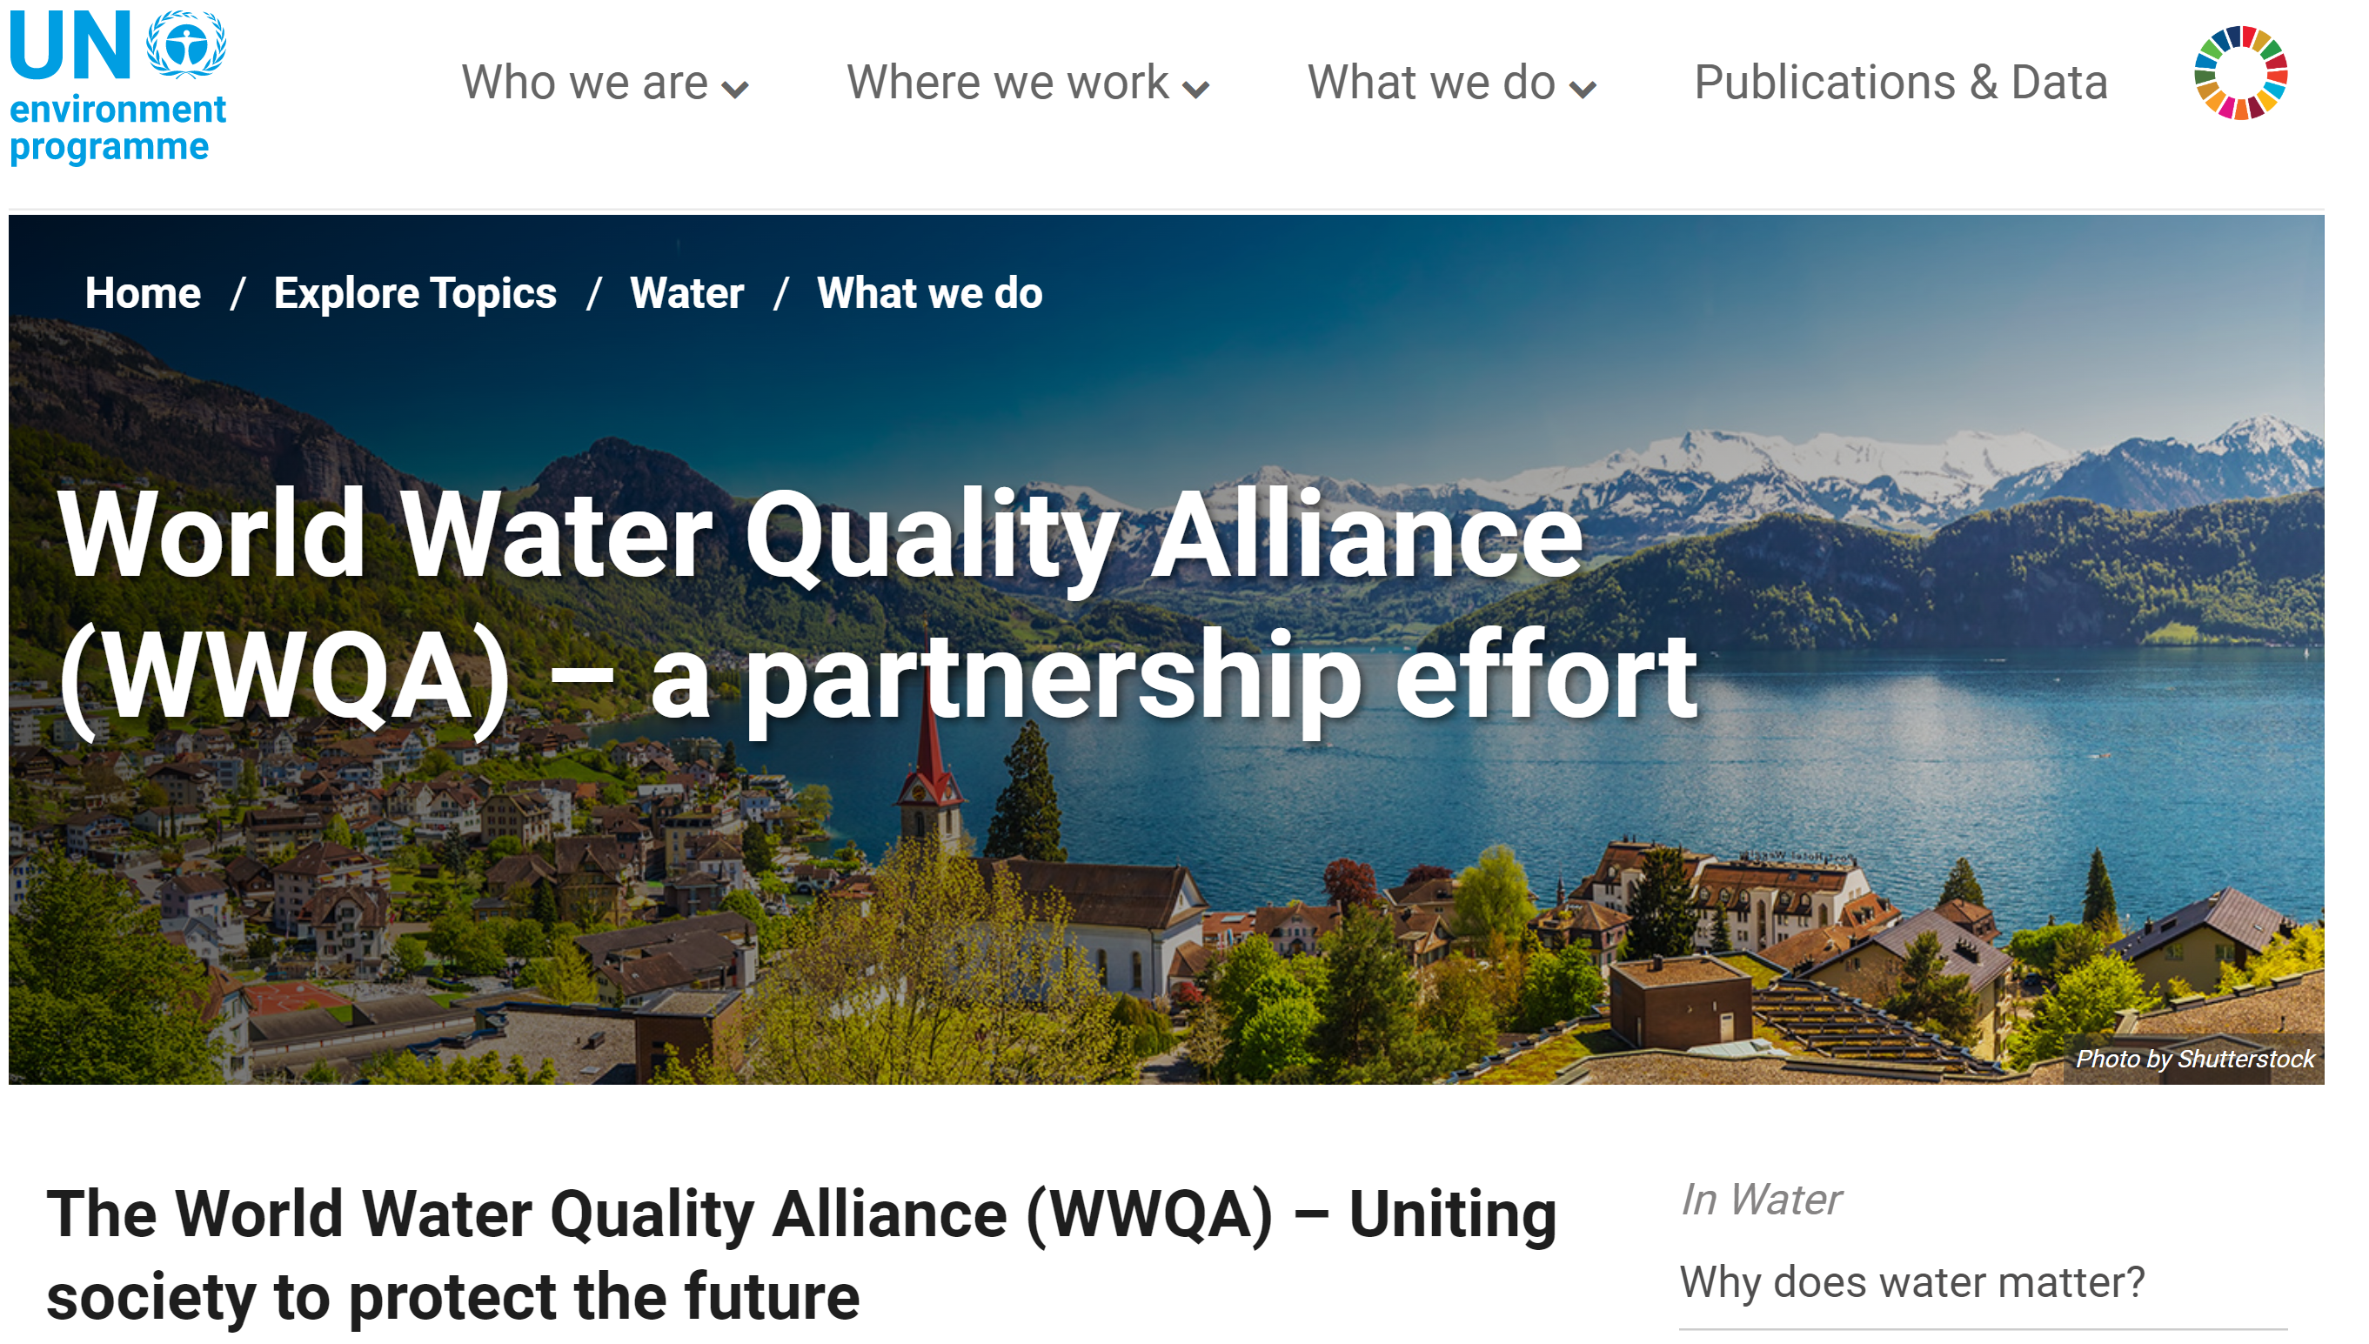
The purpose of the World Water Quality Alliance (WWQA) is to engage and unite society to protect water quality and to redress water quality deterioration, which is one of the great challenges of the 21st Century.

Slide 2
The WWQA embodies a voluntary, multi-stakeholder network that works as a genuine partnership, an open community of practice. The WWQA focuses on improving the quality of water around the world through monitoring, analysis, research, communication and identifying solutions for the maintenance and restoration of impaired aquatic ecosystems.
The WWQA aims to provide a participatory platform for water quality assessments, issues and solutions and invites all that can play a role in protecting and improving water quality, no matter their qualifications or expertise, to join the WWQA. To do so, an email can be sent to wwqa-coordination@un.org stating which workstream/s you would like to contribute to, a short summary of your organization and how the work your organization links to the specific workstream/s of the WWQA.

Slide 5
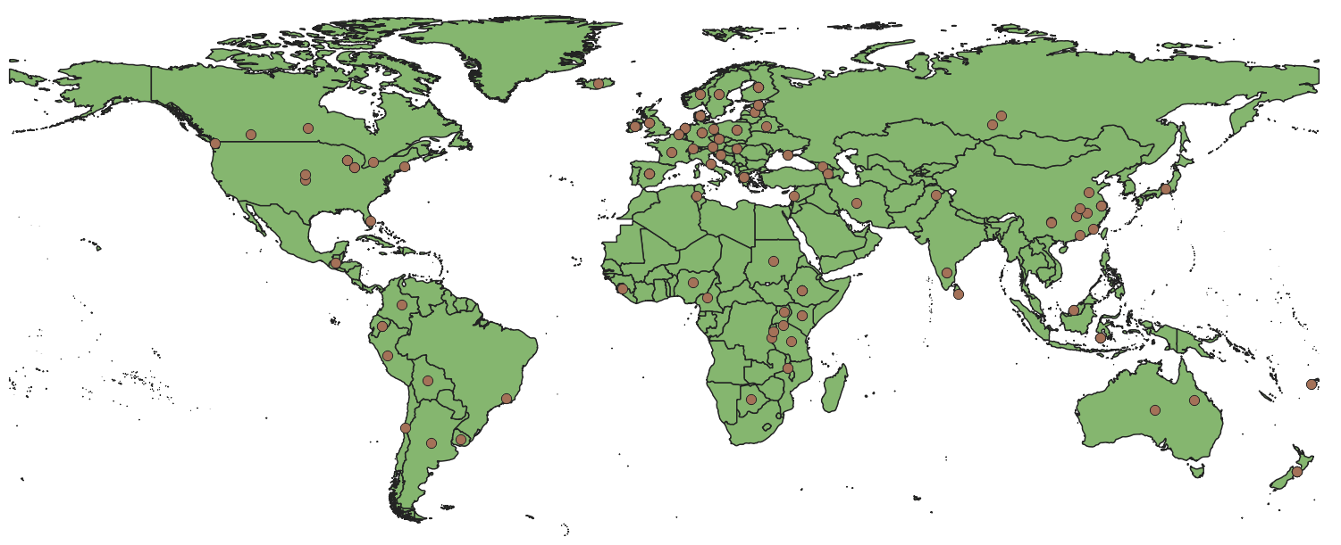
179 responders, 64 countries August 2022
poor understanding of pressures and their effects is perceived to be one of the most important reasons behind failure in lake restoration,
most restoration programmes do not consider future climate change in their long-term planning, and,
novel pressures will call for new approaches to lake restoration, both in setting restoration targets and devising restoration strategies.

Slide 7
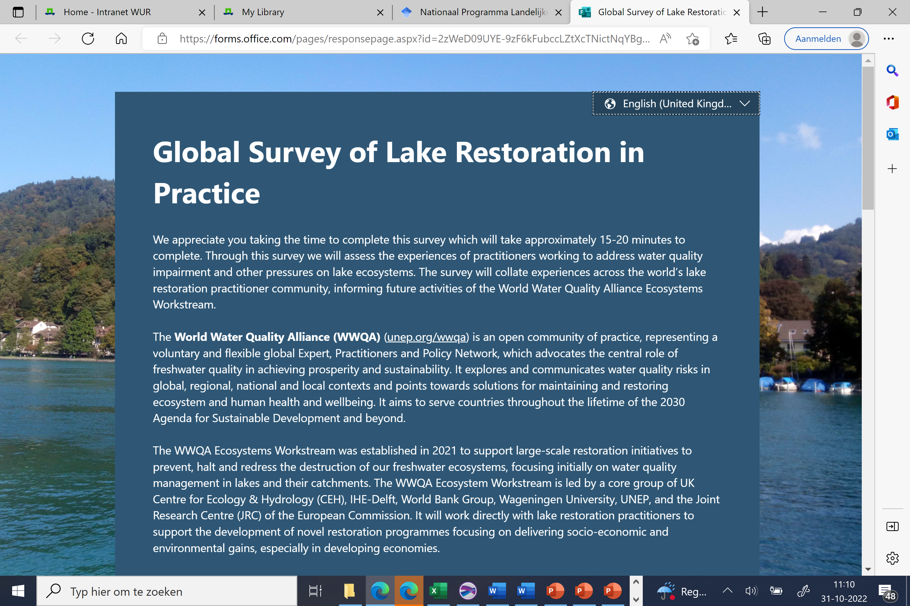
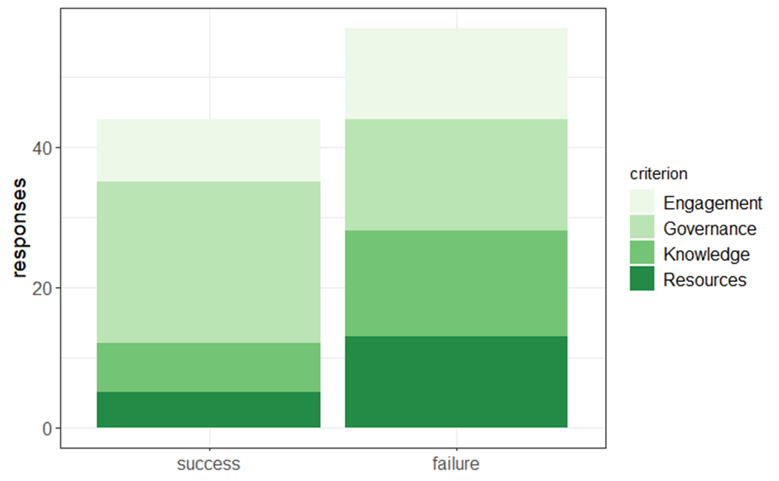
GLOBAL SURVEY OF LAKE RESTORATION IN PRACTICE
Survey is nog open, te vinden:
https://forms.office.com/r/uFnKsxLT5M

